Slide 1
CEN511: EMBEDDED SYSTEMS DESIGN AND PROGRAMMING
COURSE LECTURERS
ODUSAMI MODUPE (Engr.)
OMORUYI OSEMWEGIE

Slide 2
Module 5- Analogue Digital Conversion and Digital Analogue Conversion in Microcontrollers
ADC- Arduino, PIC
DAC- Arduino, PIC

Slide 3
Introduction
Most transducers produce output signals that are an analog of the quantity they represent. Example, the voltage output from a temperature sensor represents the temperature as faithfully as it can, increasing or decreasing as the temperature does the same.
Similarly, a microphone output signal represents the precise characteristics of the sound wave as best it can, in amplitude, frequency and waveform.

Slide 4
Properties of Analogue and Digital Quantities
Properties | Analogue | Digital
Means of (electrical) representation | A continuously variable voltage, or current, represents the variable. | Variable is represented by a binary number.
Precision of representation | Can take infinite range of values; absolute precision is theoretically possible. | Only a fixed number of digit combinations are available to represent measure
Resistance to signal degradation | Almost inevitably suffers from drift, attenuation, distortion, interference. Cannot completely recover from these. | Digital representation is intrinsically tolerant of most forms of signal degradation.
Processing | Analog signal processing using op amps and other circuits has reached sophisticated levels, but is ultimately limited in flexibility and always suffers from signal degradation. | Powerful computer-based techniques available.
Storage | Genuine analog storage for any length of time is almost impossible. | All major semiconductor memory technologies are digital.

Slide 5
Analogue to Digital Conversion

Slide 6
ADC Resolution
A measure of the fineness of conversion is called the resolution. This is the amount by which the input has to change to go from one output value up to the next. In the diagram, the resolution is the width of one step in the conversion characteristic.
An ADC with n output bits can take 2n possible output values, from 0 up to 2n −1. It therefore has a resolution of Vr/2n, where Vr is the input voltage range.

Slide 7
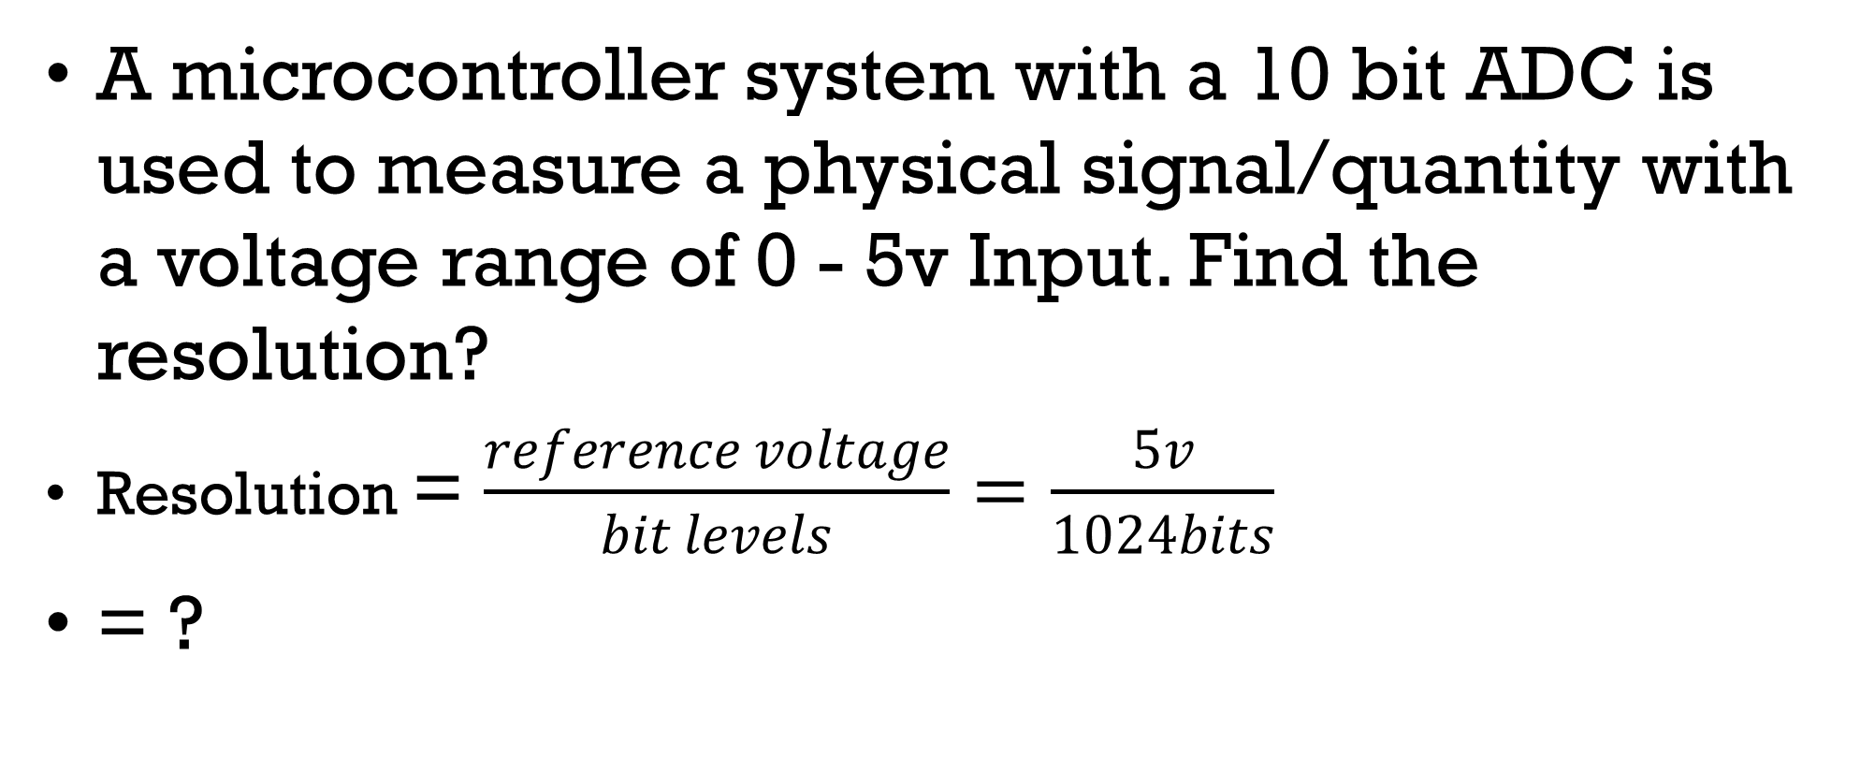
Example
A microcontroller system with a 10 bit ADC is used to measure a physical signal/quantity with a voltage range of 0 - 5v Input. Find the resolution?
Resolution = $\frac{reference voltage}{bit levels}=\frac{5v}{1024bits}$
= ?

Slide 8
Signal conditioning – Amplification and Filtering
To make best use of the ADC, the input voltage should traverse as much of its input range as possible, without exceeding it. Yet most signal sources, say a microphone or thermocouple, produce very small voltages. Therefore, in many cases amplification is needed to exploit the range to best effect. Voltage level shifting may also be required, for example, if the signal source is bipolar while the ADC input is unipolar(voltage is positive only).
If the signal being converted is periodic, then a fundamental requirement of conversion is that the conversion rate must be at least twice the highest signal frequency. This is known as the Nyquist sampling criterion. If this criterion is not met, then a deeply unpleasant form of signal corruption takes place, known as aliasing

Slide 9
References
Wilmshurst, T. (2006). Designing embedded systems with PIC microcontrollers: principles and applications. Elsevier.

